Slide 1
Presenter notes
Resources:
Docs: Securing your repository
Docs: About GitHub Advanced Security
Docs: Managing Security Vulnerabilities
Docs: Finding security vulnerabilities and errors in your code
Docs: Configuring Advanced Security features in GHES
Docs: Publishing a security advisory
About CVE
CVE Numbering Authorities
CNCF Annual Report
Demo prep:
No formal demo included
(Optional) Show demo of Dependabot
(Optional) Show demo of CodeQL
FAQ: See the speaker’s notes
Customer stories:
N/A
Expected timing:
15-20 minutes

Slide 2
Security on GitHub
GitHub Bootcamp
@presenter name (optional)

Slide 3
This module will enable you to:
Discuss GitHub security features and policies Note: This is a simplified version of the full GitHub Advanced Security bootcamp content

Slide 4
Agenda
Setting the scene
Dependency management
Security policies
Code scanning
Secret scanning
Notes:
First, we'll set the scene and discuss how security can be integrated into software development.
Then, we will discuss the features and functionalities that GitHub offers to integrate security practices into every step of the development process
Please feel free at anytime pose questions.

Slide 5
Setting the scene
Notes:
Let's compare 3 scenarios, and talk about how security is typically handled in workflows. We'll talk about Advanced Security features after we review this. Contrasting to see what things look like without and with advanced security.

Slide 6
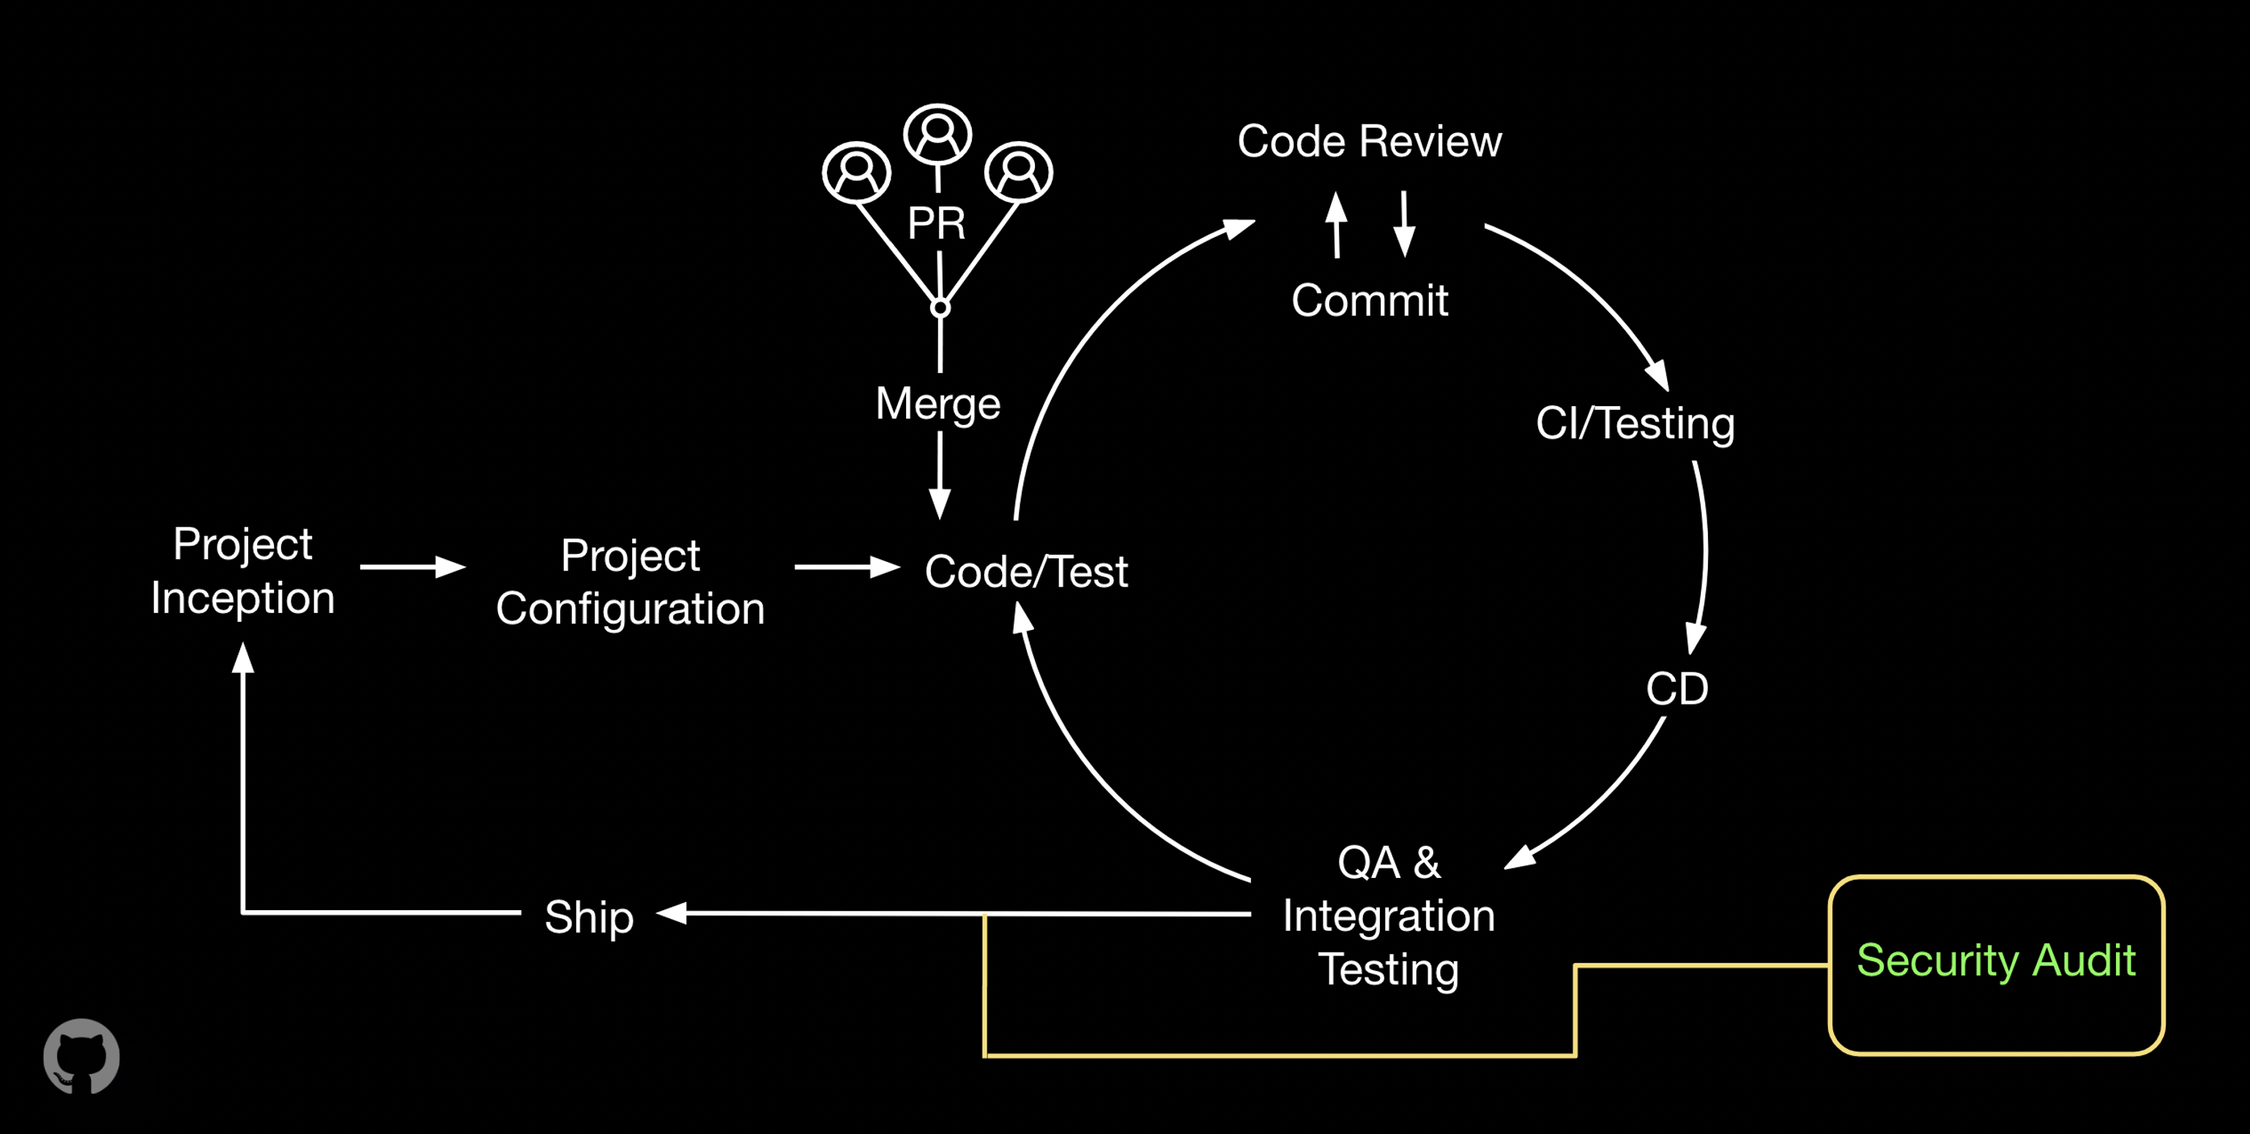
Notes:
Example of basic security scenario.
Relatively standard value stream mapping, though different organizations and teams may have differences.
Notice the cycle from idea to code, including testing and deployment.
The security audit is completely removed from that process. In this situation, security is in the hands of a smaller team, with less context about the broader codebase and product approach.

Slide 7
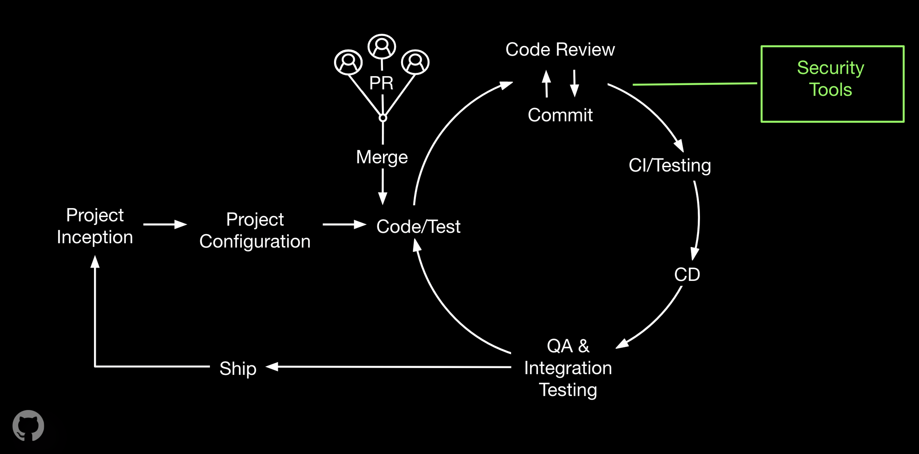
Notes:
In this slightly improved scenario, we still have one step of security, and it’s integtated more closely into the development workflow.
Moving security checks to happen more frequently and in context is a big improvement – but there’s more room to grow.

Slide 8
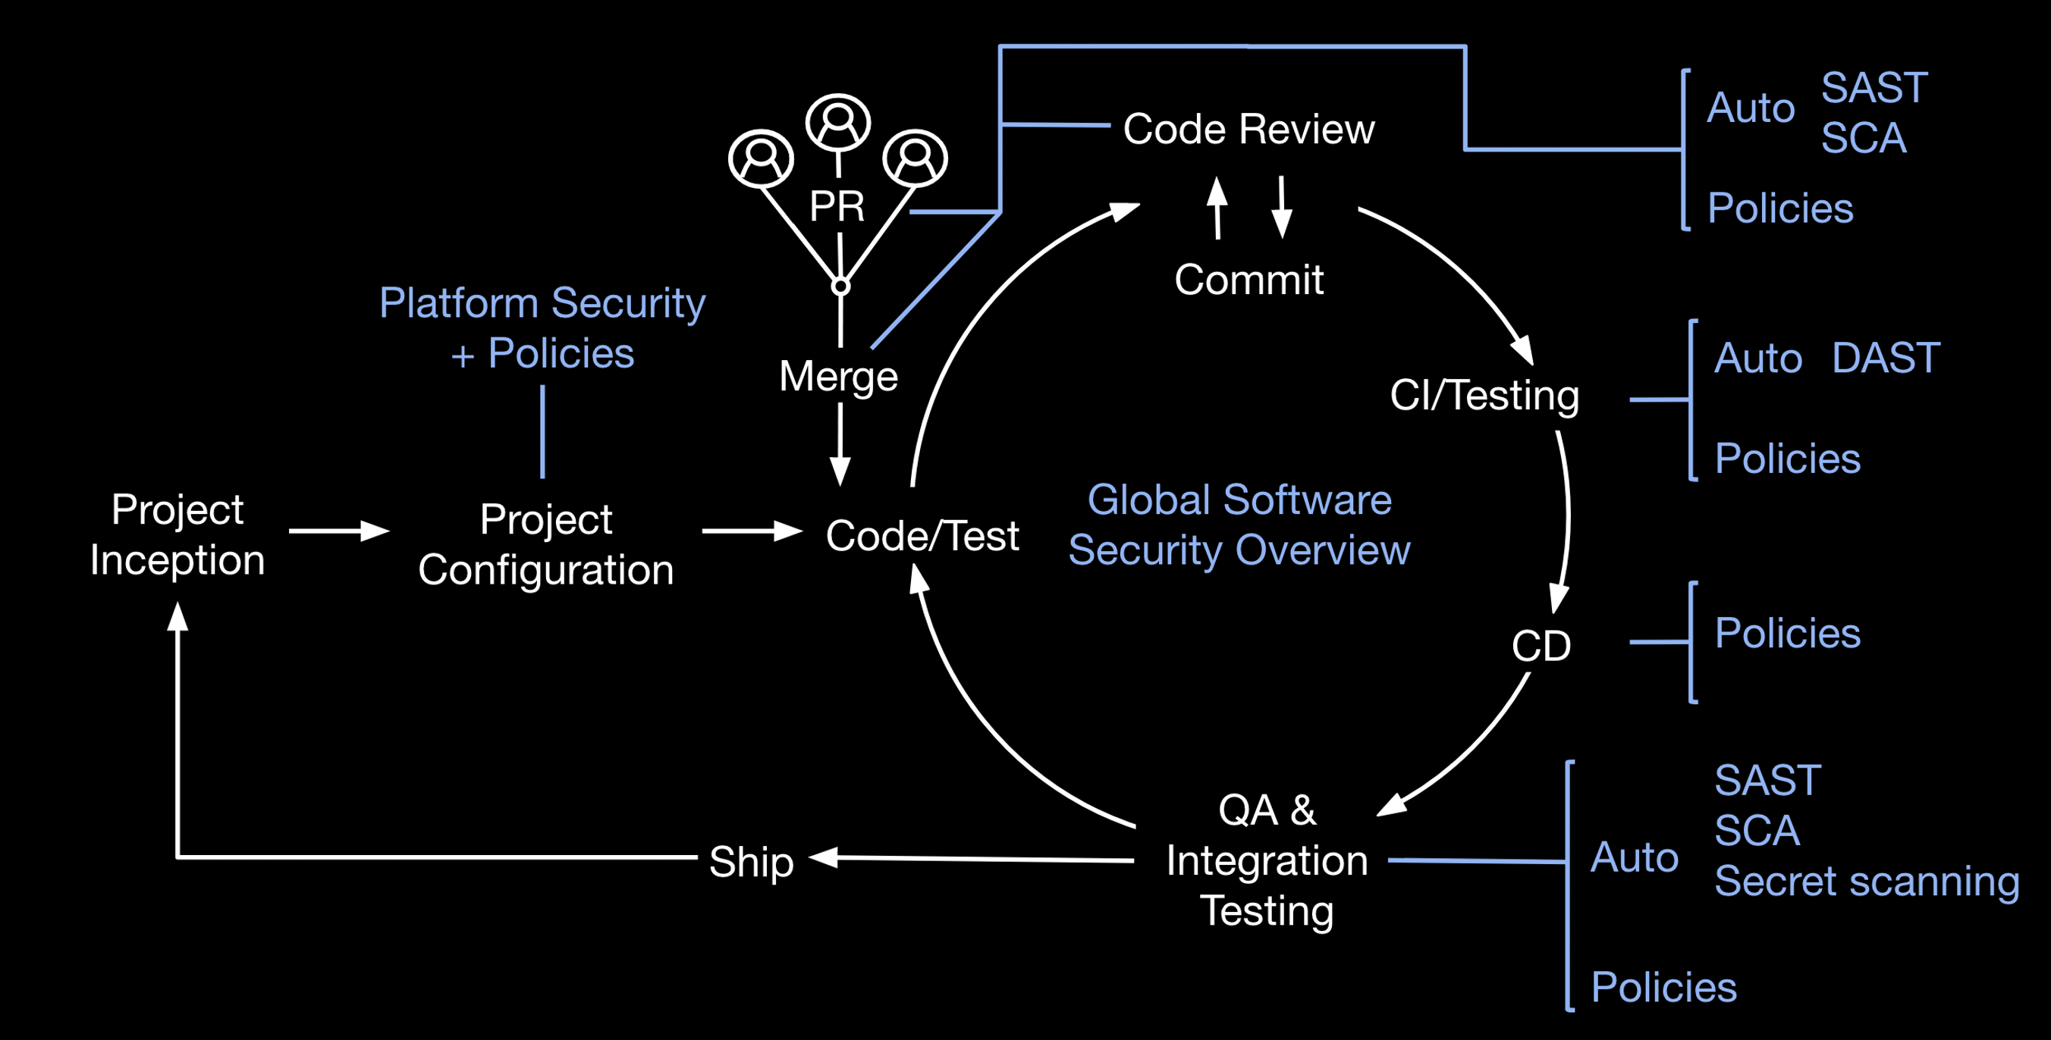
Notes:
Tools AND policies
Integrating security at every step of the development lifecycle
Not only more frequent security checks, but in context. The people who know that world best are responsible for security at those stages.

Slide 9
GitHub Advanced Security: A suite of security tools that enable developers to identify security vulnerabilities in their codebases
Notes:
This is what Advanced Security means. A suite of tools and features, all together are considered Advanced Security.

Slide 10

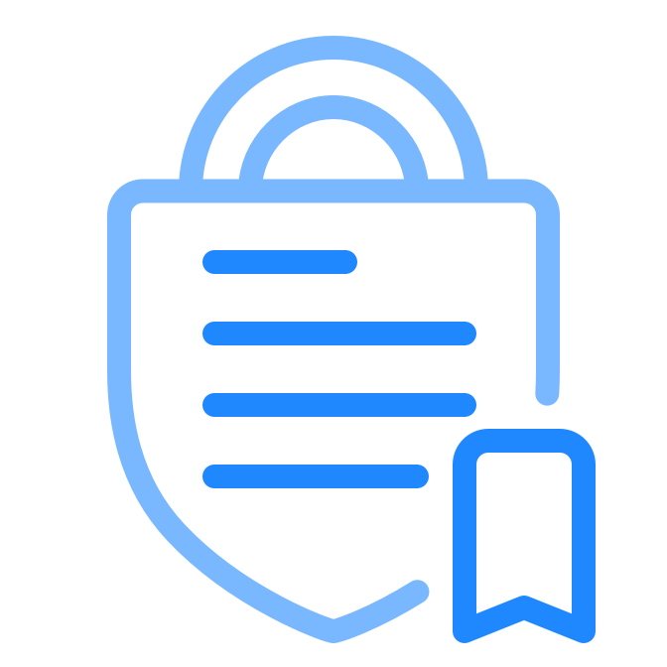

GitHub Advanced Security: current capabilities
Supply Chain
Dependency graph
Advisory database
Security alerts and updates
Dependency review
Policies
Branch protection
Commit signing
Static scanning
Secret scanning
Code scanning
Notes:
The left column shows the features that make up the bucket of "supply chain" functionality, aka dependency management
The center column represents policies, whether those are written policies, or policies enforcable by admins, like requiring all code passes certain criteria before merging into the main branch.
The right column shows the static scanning, including static code analysis and secret scanning

Slide 11
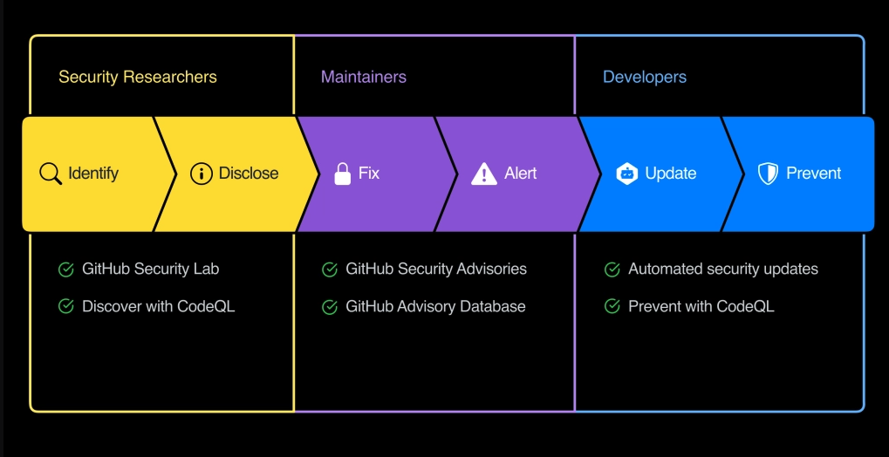
Notes:
As an alternative to thinking about these features based on their primary function (with supply chain, policies, or static sacnning), you can also think about these features based on who would interact with them.
Not every person will engage with every feature of Advanced Security in the same way.

Slide 12
Supply chain
Notes:
Let's talk about supply chain, in other words, dependency management.
What ARE my dependencies?
Are my dependencies up to date?
Remediating vulnerabilities and proactive security work, sharing solutions

Slide 13
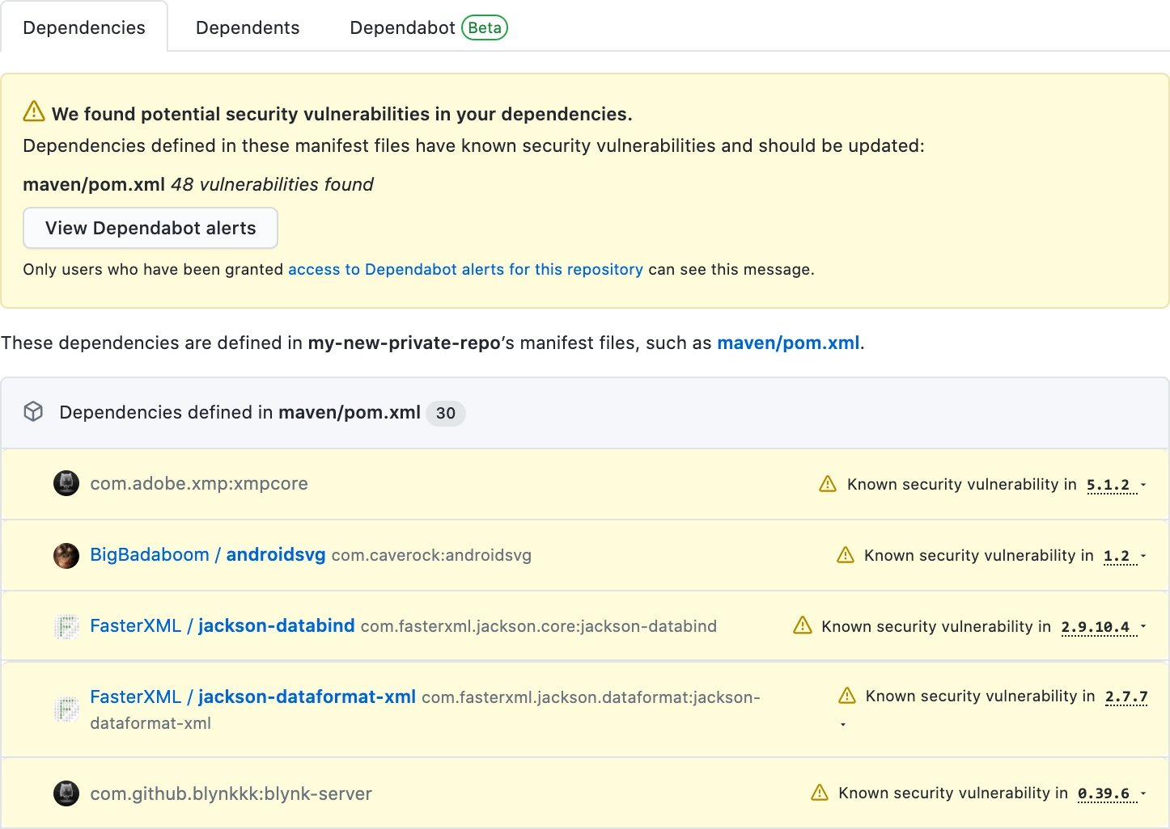
Dependency graph
Summary of manifest & lock files
Ecosystem, repository, and package dependencies
Direct and transitive dependencies
Growing language and package support
Notes:
The dependency graph helps to answer the question, "What ARE my dependencies?"
The dependency graph is available for every public repository that defines dependencies in a supported package ecosystem using a supported file format. Repository administrators can also set up the dependency graph for private repositories.
Composer, dotnet, Maven & Java, npm, Python & PIP, RubyGems & Ruby, Yarn
https://docs.github.com/en/code-security/supply-chain-security/about-the-dependency-graph#supported-package-ecosystems https://github.com/github/training-kit/network/dependencies
Security overview coming soon: https://github.com/orgs/githubpartners/security as internal example

Slide 14

Dependabot features
Detects vulnerable dependencies and raises alerts
Automatically fix dependency vulnerabilities via pull requests
Notify appropriate people
Rate patch compatibility
Notes:
Dependabot helps to answer the question, "Are my dependnecies up to date?" And it helps to KEEP dependencies up to date.
THIS IS MUCH EASIER TO SHOW THAN TO TELL.
Dependabot security updates make it easier for you to fix vulnerable dependencies in your repository.
If you enable this feature, when a Dependabot alert is raised for a vulnerable dependency in the dependency graph of your repository, Dependabot automatically tries to fix it. Dependabot security updates may include compatibility scores to let you know whether updating a vulnerability could cause breaking changes to your project.
These are calculated from CI tests in other public repositories where the same security update has been generated.
Dependabot is highly configurable, via dependabot.yml file. You can also customize the notification settings. https://docs.github.com/en/code-security/supply-chain-security/about-alerts-for-vulnerable-dependencies https://github.com/githubtraining/ci-circle-template/pull/5 https://docs.github.com/en/code-security/supply-chain-security/configuring-dependabot-security-updates https://docs.github.com/en/code-security/supply-chain-security/configuring-notifications-for-vulnerable-dependencies
More details on configuration with / directory option: >Some projects may have multiple components with different dependency libraries.
To add to that, some languages and ecosystems may have a non-standard scaffolding/project layout (or teams may choose a non-standard project layout), in which case the manifest files are now located in a subdirectory.
More details on package-ecosystem vs package-manager: Yes, for example for Python you have both the pip and poet package managers that work with the pip package-ecosystem. The package manager contains all the logic for managing your dependencies and specifies the format of the package manifest. The ecosystem specifies the package registry that Dependabot can use to determine if there are new versions available that can be used in a security update.

Slide 15
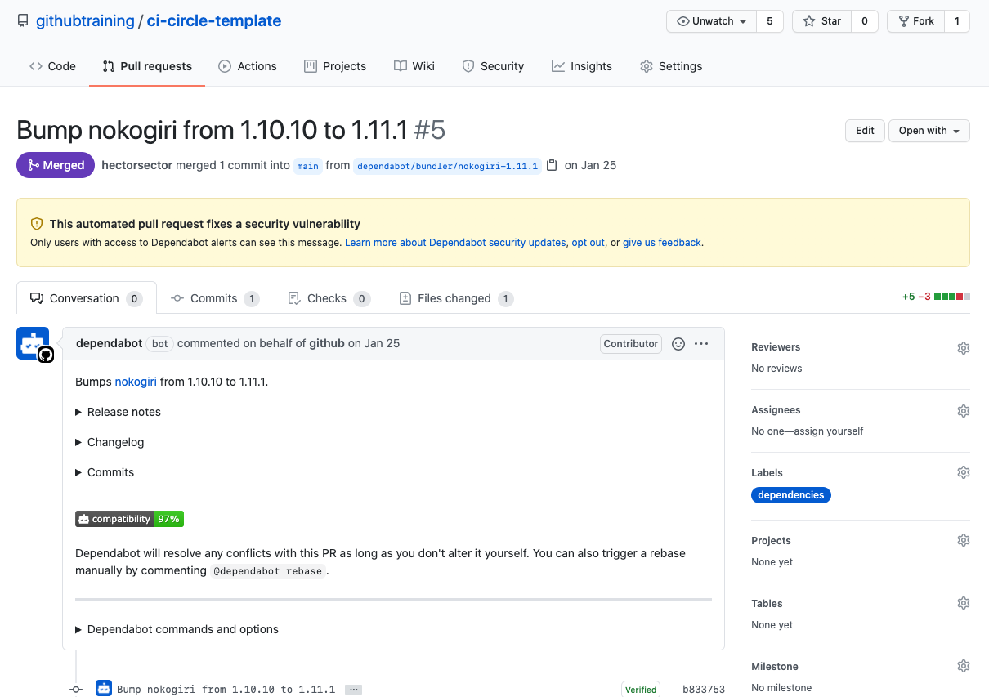
Inside an alert
https://github.com/githubtraining/ci-circle-template/pull/5
Notes:
This alert has had a pull request automatically opened for it by dependabot. https://github.com/githubtraining/ci-circle-template/pull/5
Dependabot is highly configurable, via dependabot.yml file. You can also customize the notification settings.

Slide 16
Security databases inform Dependabot
National Vulnerability Database
Combining ML & human review
Security advisories reported on GitHub
npm Security Advisories Database
Notes:
Where does Dependabot get its information? Dependabot uses the GitHub Advisory Database. Curated list of security vulnerabilities from sources listed. GitHub reviews each published security advisory, adds it to the GitHub Advisory Database, and may use the security advisory to send Dependabot alerts to affected repositories.

Slide 17
Questions

Slide 18
Security policy and advisories
Notes:
Fix and publish vulnerability information Now that you’ve identified a vulnerability, what next? ​How do you manage security within your own repositories?
GitHub offers easy solutions to share critical information about vulnerabilities to millions of other open-source developers.

Slide 19
SECURITY.md
Must be in one of 3 locations:
Root of your repository
In a “docs” folder
In the “.github” folder
Notes:
Provide instructions for responsibly reporting security vulnerabilities in your project.​You can give instructions for how to responsibly report a security vulnerability in your project by adding a security policy to your repository.
Example: https://github.com/microsoft/vscode/blob/main/SECURITY.md

Slide 20
Security advisories
Draft security advisory
Privately collaborate in private fork
Publish security advisory to alert your community
Notes:
Most critically – security advisories give open source projects on GitHub a way to securely discuss sensitive security issues.
https://github.com/github/training-kit/security/advisories, or show another example that you have access to if possible.
Don't want to handle security vulnerabilities in public, until fixes have been implemented.
Create a private fork as a "security advisory", where the right people can discuss and test.
Then, publish the security advisory to alert your community​

Slide 21
Enforcing policies with protected branches
Protected branches allow you to enforce certain requirements
Tests passing (including code scanning)
Approvals
Notes:
Protected branches play an important role in enforcing policies
Use a CODEOWNERS file to specify who needs to approve changes on specific files
Enforce rules for administrators, as well
Tests passing = includes code scanning, which we’ll cover soon

Slide 22
Questions

Slide 23
Code security
Notes:
Secret scanning is different than code scanning
Code scanning (with CodeQL) is the main feature/technology referenced when discussing Advanced Security

Slide 24
Code security capabilities
Code scanning with CodeQL
Secret scanning
Notes:
Code Scanning
Static analysis of every git push, integrated into the developer workflow and powered by CodeQL
CodeQL
Code analysis engine that allows accurate querying of a codebase to find variants of a vulnerability
Secret Scanning
Automatic notifications of any API tokens or other secrets exposed anywhere in your hit history

Slide 25
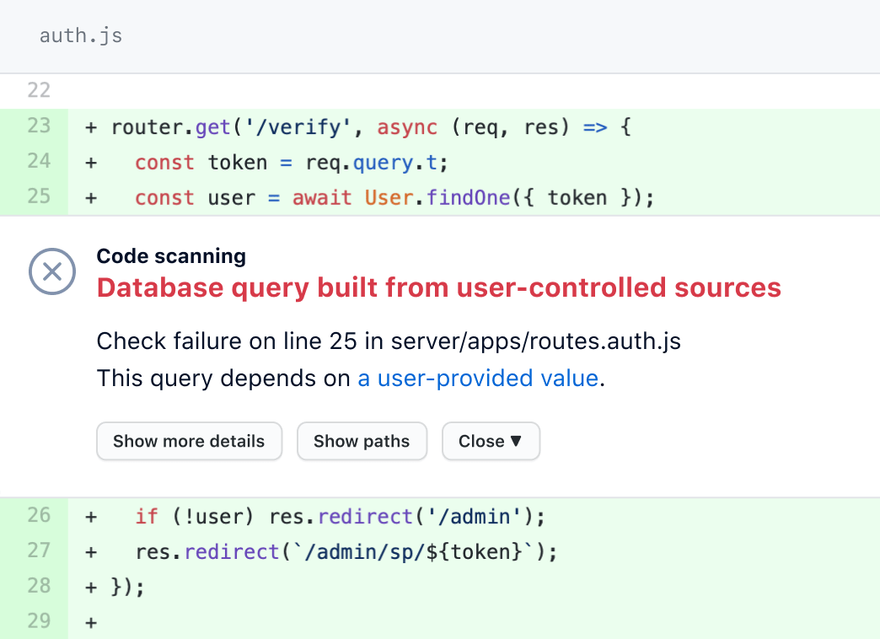
Code scanning
Scan code upon committing it to the branch
Actionable security reviews
In pull requests with other tests
Notes:
Benefit from huge library of existing security tests
Code scanning: Static analysis of every Git push, integrated into the developer workflow and powered by CodeQL
Code scanning is incredibly powerful
Benefit from huge, ever-growing library of existing security tests
CodeQL: Code analysis engine that allows accurate querying of a codebase to find variants of a vulnerability
Find vulnerabilities before they're merged
Scan code upon committing it to the branch
Integrate results directly into developer workflow
Run custom queries in addition to community-powered GitHub query set
Extensible, with support for other static application security testing tools
Benefit from huge library of existing security tests
SAST = Static application security testing
Common commercial SAST tools we see with customers are Checkmarx , Coverity, VeraCode, and CodeQL ;).
Security researchers typically don't use SAST tools because most of them aren't customizable to fit the workflow or require specialized knowledge. This is changing with the advent of tools like CodeQL and semgrep that are freely available to security researchers. However, it remains more common for security researchers to use techniques like code reviewing and fuzzing. (automated security process working best for systems with structured input, providing "valid enough" input and watching for exceptions)

Slide 26
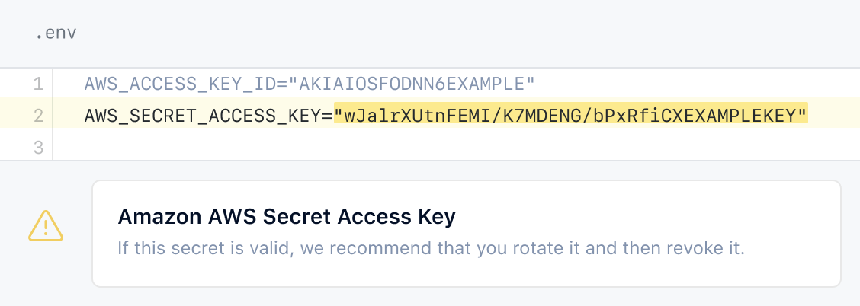
Secret scanning for private repositories
Keep secrets out of your code
GitHub notifies you of secrets issued by 30+ secret providers
Notes:
Find secrets the moment they’re pushed to GitHub
Scan your entire git history
Easily exclude false positives
Automatically disable or suspend secrets from 25+ service providers as soon as they’re committed
User secrets can be disabled or rolled over.

Slide 27
Questions

